Slide 1
Personal Loan Analysis and Visualization with
Lending Club Data
Linlin Cheng
Linlin.cheng@nyu.edu
07/17/2016
Visualization Project Presentation

Slide 2
Linlin Cheng | cheng@econ.umd.edu
Table of Contents:
I. Introduction
II. Data and Methodology
III. Analysis
IV. Conclusion
V. Questions

Slide 3
Introduction
LendingClub Corp, LC:
The largest online P2P platform
Founded in 2006, headquartered in San Francisco
Attracted over $1 billion in IPO in 2014, but suffered scandals from management level and decline in investor in the last few years
This project focuses on:
Analyzing the loan payment record of its past loans as reference
Providing the investors, borrowers additional view of the investment opportunities
Offering the company insights regarding risk management and targeted area management for outstanding loans

Slide 4
Data and Methodology
Source: Kaggle.com
73 columns and 887380 rows
Extensive information on the borrower's side:
interest rate charged upon issuing
borrower’s personal demographic information,
loan status, etc
In order to reduce unnecessary information, this project only focus on the variables with relatively less amount of missing entries to amplified the visualization effects.

Slide 5
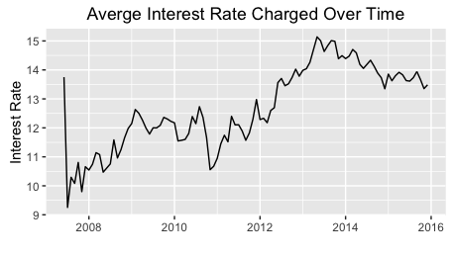
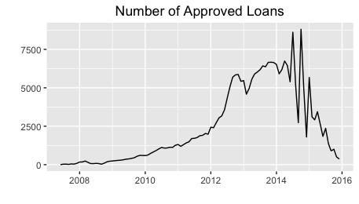
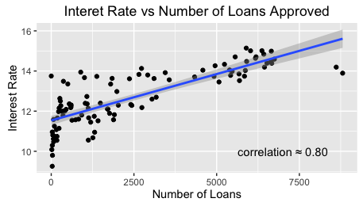
Analysis I: Interest Rate VS. Number of Loans

Slide 6
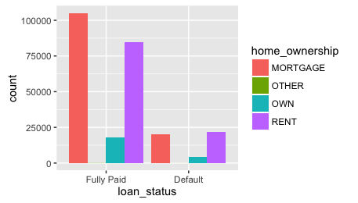
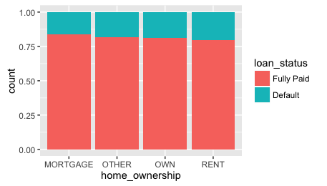
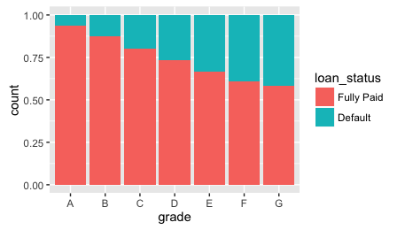
Analysis II: Loan composition breakdown

Slide 7
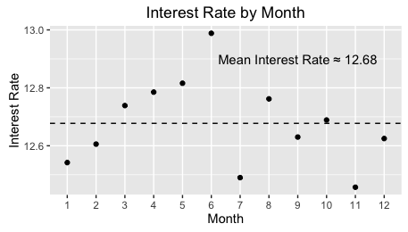
Analysis III: Interest Rate by Month

Slide 8
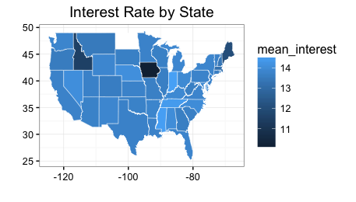
Analysis IV: Interest Rate by State
Note: unavailable information for North Dakota, as the state hasn’t legalized P2P.

Slide 9
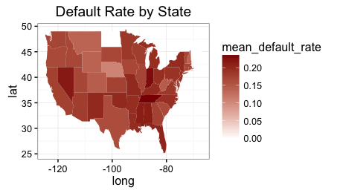
Analysis IV: Default Rate by State
Note: unavailable information for North Dakota, as the state hasn’t legalized P2P.

Slide 10
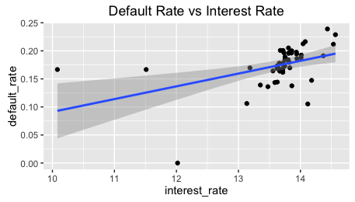
Analysis

Slide 11
Analysis V: Default Rate vs. Interest Rate

Slide 12
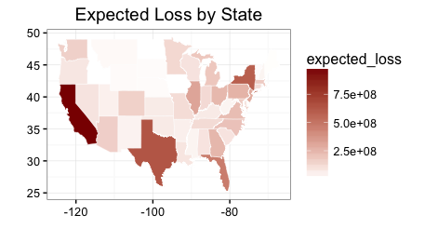
Analysis VI: Expected Loss Preview
Prediction based on a logistic probability estimation based on annual income, funded amount, home ownership, lender’s grade rating, and installment with a threshold of 0.7.

Slide 13
Conclusions and Suggestions
In general: the dataset presents similar patterns as predicted by economic theories:
Number of Loans vs. Interest Rate
Default Rate vs. Interest Rate
The majority of borrowers are not home owners, but there is an equal percentage of default for all housing type categories.
For borrowers:
Idaho, Iowa, and Maine are the states with lower interest rates
July and November are the months with better rates
For Lending Club:
Tennessee, Michigan, and Florida are risking high default rates
California, Texas, New York, and Florida are of high risks in total loss

Slide 14
Questions?

